Slide 1
SERIAL PERIPHERAL INTERFACE (SPI)
By Angel Rosas De Luis

Slide 2
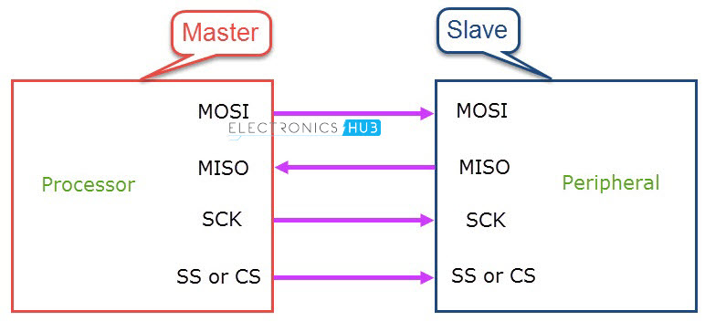
What is an SPI?
A serial peripheral interface or SPI is a synchronous serial communication protocol that can provide full duplex communication between a microcontroller and its peripherals.
In short distances, an SPI can provide serial communication at very high speeds.
Developed by Motorola in the 1980s.

Slide 3
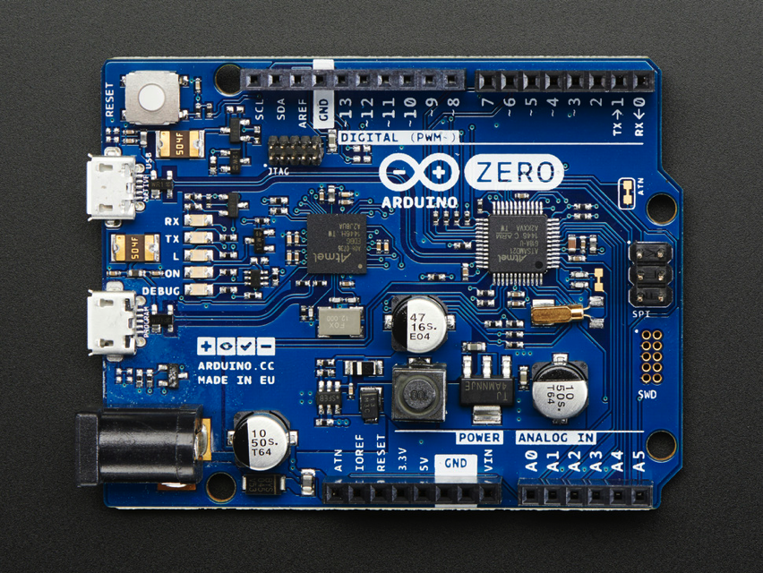
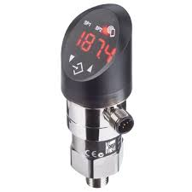
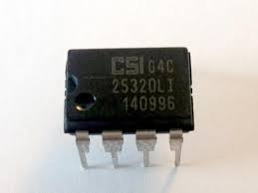
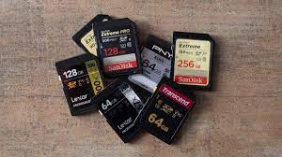
Applications of SPI
The SPI protocol is often seen being used in:
Memory devices such as SD cards and EEPROM
Temperature and pressure sensors
Microcontrollers such as Arduinos

Slide 4
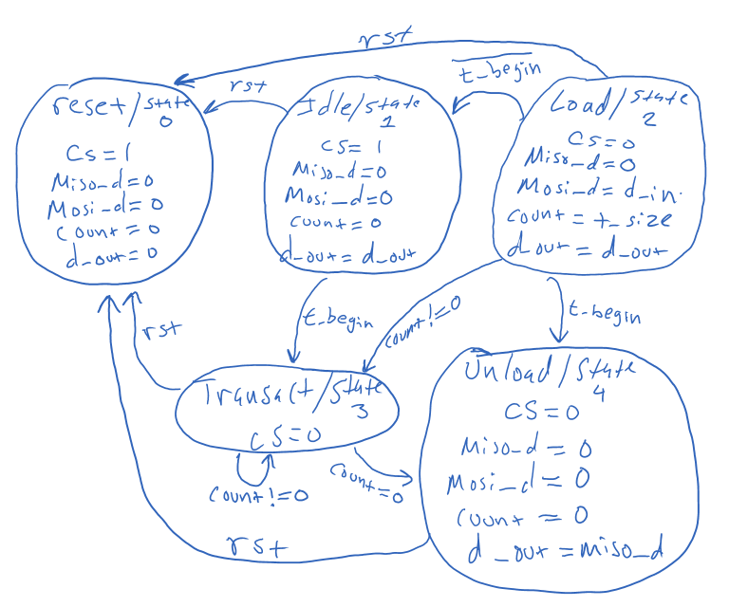
SPI state machine Diagram

Slide 5
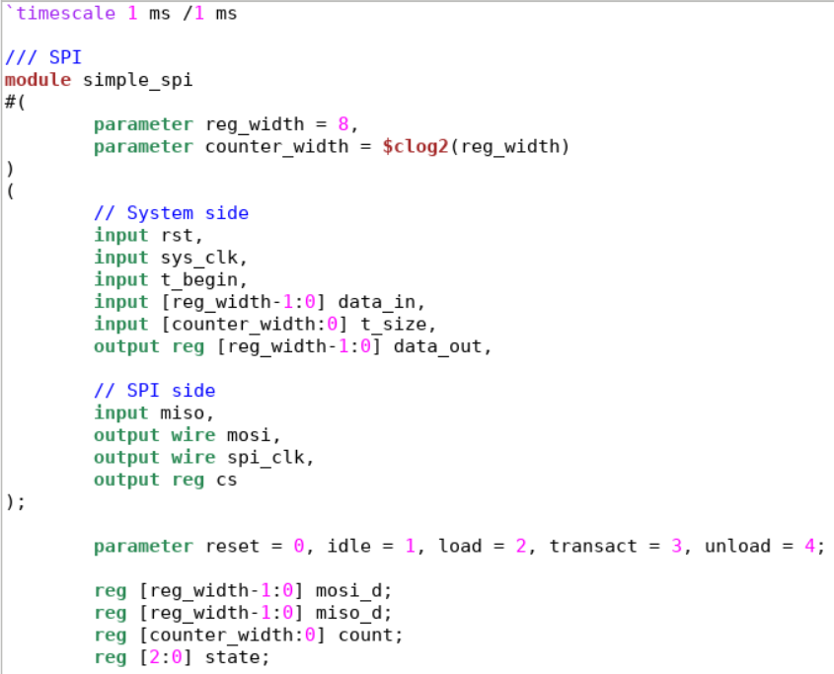
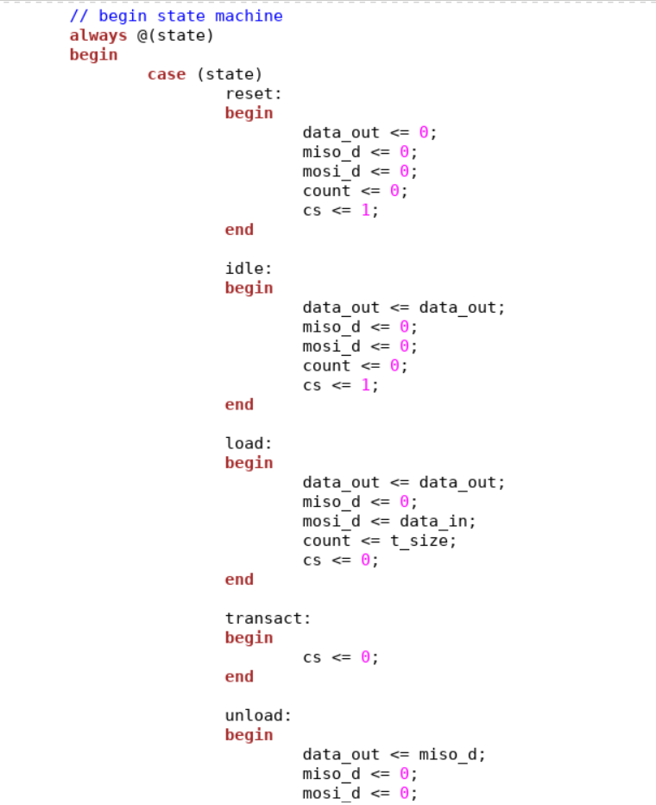
SPI Source code

Slide 6
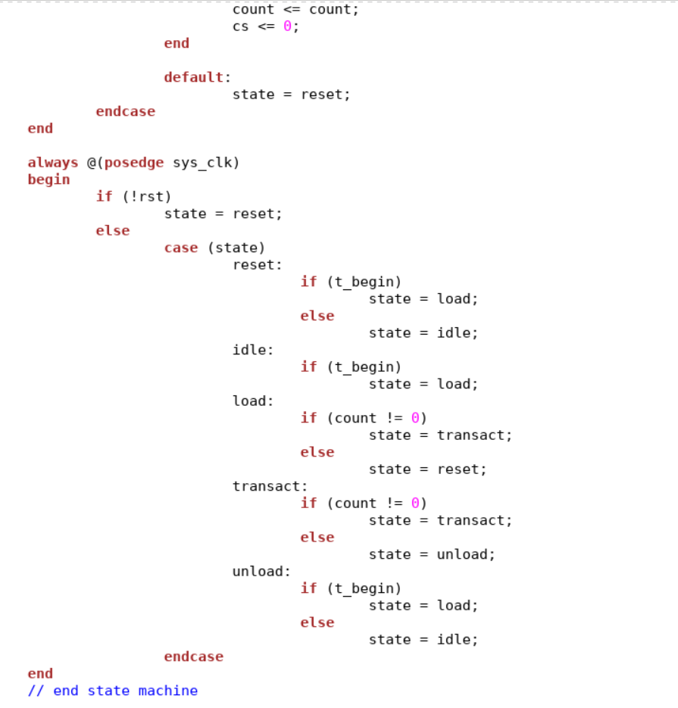
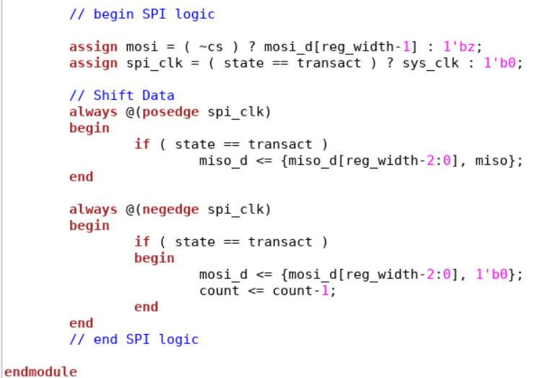
SPI Source code contd.

Slide 7
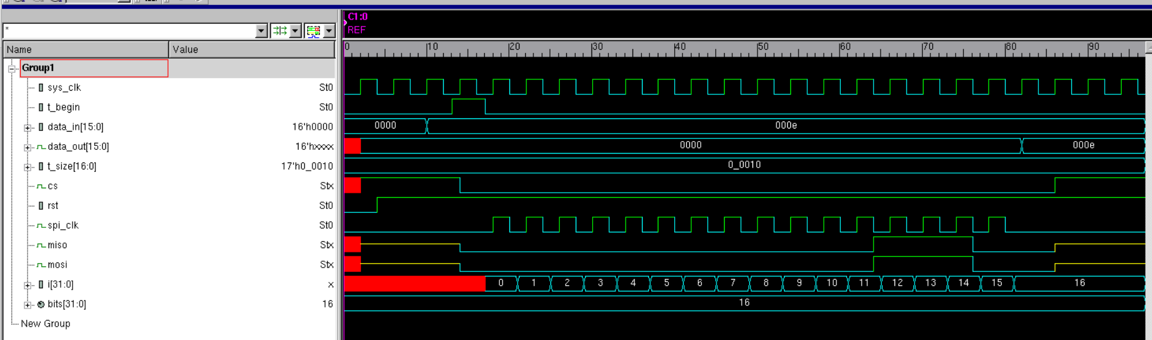
SPI Simulation Results

Slide 8
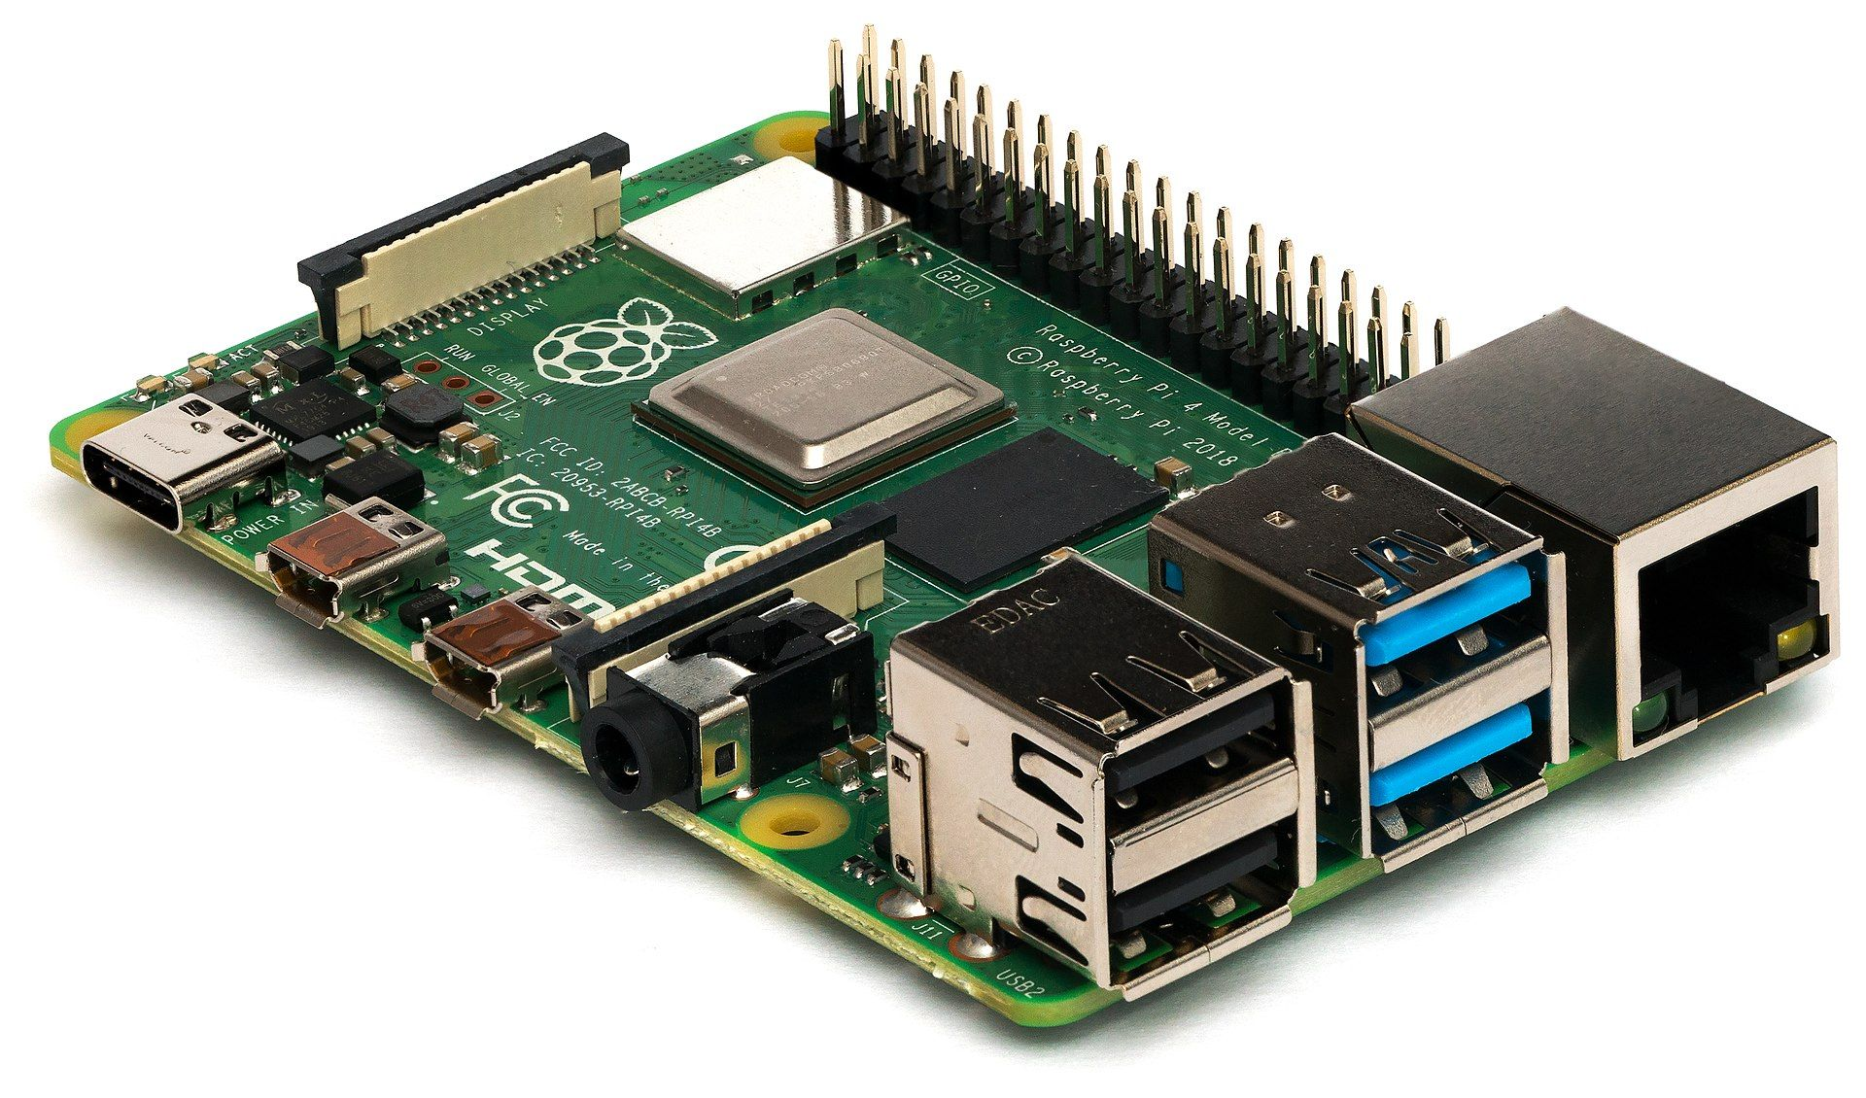
Thank You

